Slide 1
Control Types
Each Control is Asp.net Comes with user interface[textbox, button, etc]
Each Control in Asp. Net in the form of class with set of properties methods and events.
In General Controls are two types:
Client control: the control object is created by browser is called "Client side control" this object can be used in client side scripting, it is not accessible in server side coding
Ex:<input type="text" id="t1"> it is an instruction to browser to create textbox object.
Note: Asp 3.0 supports only client side controls

Slide 2
Server Controls
server side controls: the control object is created with in Web Server is called "server side controls” Server side Control object can be accessible with in server side programming[code behind page].
server side control makes developer job easier and development faster.
server control can be divided into two types.
html server controls
web server controls

Slide 3
Server Controls
Htmlserver controls: this controls are created based on client side controls with similar syntax
Ex: <input type="text" id="t1" runat="server"/>
Webserver controls:
Web server controls are the controls with more built-in features than HTML server controls.
Web server controls include not only form controls such as buttons and text boxes, but also controls of special purpose such as a data controls, calendar, menus, and a tree view control.
Web server controls are more flexible than HTML server controls.
<asp:control_name id="some_id" runat="server" />
<asp:TextBox ID="TextBox1" runat="server"></asp:TextBox>

Slide 4
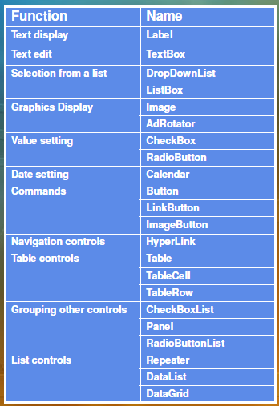

Slide 5
Control Types
Label:
To Represent Static text on Webpage.
Button:
Displays a push button control on the Web page.
Text Box:
Displays a text box control for user input, and can be edited by users at run time or changed programmatically
Check Box:
Displays a check box that allows the user to select a true or false condition.
Radio Button:
Represents a radio button.

Slide 6
Control Types
ListBox:
Represents a list box control that allows single or multiple item selection
DropDownList:
Represents a control that allows the user to select a single item from a drop-down list
Menu:
Menu displays a menu in a Web Forms page
FileUpload:
Displays a text box control and a browse button that allow users to select a file to upload to the server.

Slide 7
Control Types
Advertisement Rotator:
Displays an advertisement banner [A sequence (predefined or random) of images.] on a Web page.
Calendar:
Displays a single-month calendar that allows the user to select dates and move to the following or preceding month.
Tree View:
Displays hierarchical data, such as a table of contents, in a tree structure.

Slide 8
Control Types
Panel:
Represents a control that acts as a container for other controls.
Place Holder:
Stores dynamically added server controls on the Web page and enables to dynamically add child elements to it at run-time.
Literal:
Reserves a location on the Web page to display static text and renders static text into a Web page without adding any HTML element.

Slide 9
Control Types
Repeater:
A data-bound list control that allows custom layout by repeating a specified template for each item displayed in the list.
Form View:
Displays the values of a single record from a data source using templates defined by user.
The FormViewcontrol allows you to edit, delete, and insert records.
Data Grid:
This is a data bound list control that displays the items from data source in a table. The DataGridcontrol allows you to select, sort, and edit these.

Slide 10
Control Types
Data List:
This is a data bound list control that displays items using templates. This is like the Repeatercontrol, but with more formatting and layout options.
Details View:
This displays the values of a single record from a data source in a table, allows you to edit, delete, and insert records.
Grid View:
This displays the values of a data source in a table where each column represents a field and each row represents a record.
The GridViewcontrol allows you to select, sort, and edit these items.
Each column represents a field, while each row represents a record.
Table:
Displays a table on a Web page

Slide 11
Control Types
Validation Controls
Required Filed Validator
Range Validator
Regular Expression Validator
Compare Validator
Custom Validator
Validation Summery

